Slide 1



April 23
Company Sales Forecast Analysis
Analyst
Ojo Jesus Olaniyi
Role
Data and Bi Analyst

Slide 2
Steps to be taken
Understanding the Business problem and the Business Goal
Ask Relevant Question to Solve Business Goal / Prepare Data for Analysis / Process The data into the right format for analysis
Analyse the Prepared data to gain insight
Share and presentation of your findings
01
02
03
04

Slide 3

Business Problem
The forecasted sales often deviate from actual sales, leading to overstocking or stockouts.
This impacts inventory costs and customer satisfaction.
Full Name
Ojo Jesuye Olaniyi
Role
Data and Bi Analyst

Slide 4
Business Goal
Improve Forecast Accuracy Over Time
Full Name
Ojo Jesuye Olaniyi
Role
Data and Bi Analyst

Slide 5
What is The Average Forcast and Average Actual_Amount with Maximum and Min Amount of Each Category
Business Question
WHat is the Average Sales Amount Of Each Weekdays by category
Product That are majorly above forcast and Product That are Majorly Below Forecast
Sales Amount Average By month
Title 5
01
02
03
04

Slide 6
FINDINGS AND RECOMMENDATIONS

Slide 7

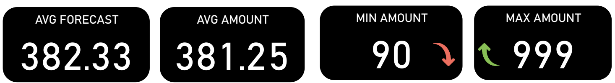
Question 1
What is The Average Forecast and Average Actual_Amount with Maximum and Min Amount of Each Category
I started by looking into the general average forecast and the general average amount with the min amount and max amount, i was able to figure out that there were little to no relation with the category average and the general average because some of the category has overall average than the other categories, though in the case of the min and max amount, there seems to be little correlation between all categories, most categories fall within the range of 90 - 95 Min amount except for coffee_Sales And Food Sales which could be affected by so many other factors if looked into. The Maximum Amount had the same correlation across all categories, which between the range of 490 - 500 amount with the exception of Coffee Sales and Food Sales Categories which both ranged in the realm of 900 + amount.

Slide 8
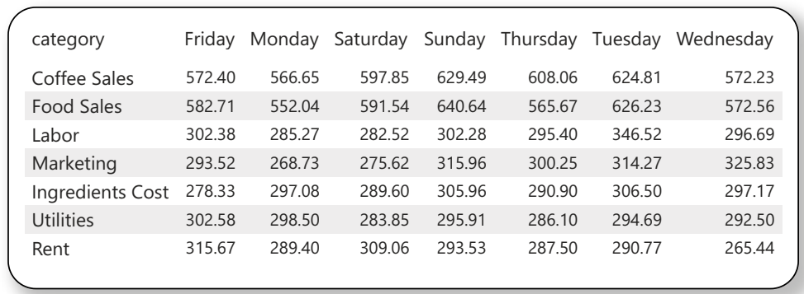
Question 2
I further my investigation of the dataset by looking into the categories to figure out the average we get by each weekday and from the table we can see, it is clear that coffee and food sales has the highest overall average ranking between 552 - 640 amount average Per day, while the labor, marketing, Ingredient Costs, Utilities and Rent average between the amount of 268 - 346 average.
WHat is the Average Sales Amount Of Each Weekdays by category

Slide 9
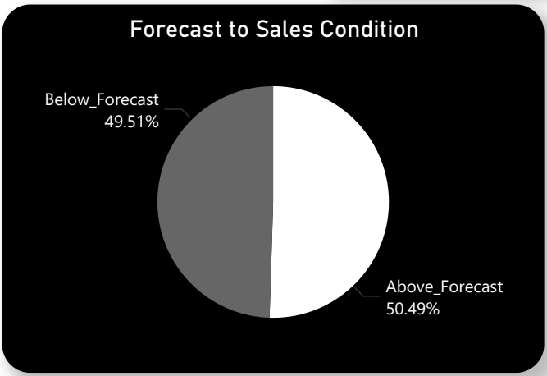
Question 3
Product That are majorly above forecast and Product That are Majorly Below Forecast
The overall total sales condition was not so bad considering that 50 percentage of the Amount made were above the forecasted amount, even though that might not be the best result, the overall sales condition seems to be doing well. Out of the 7 categories we were working with, the only one where the amount forecasted was below the forecasted amount with over 50 percent was ingredient cost, this is a disturbing outlier and should be looked into.

Slide 10
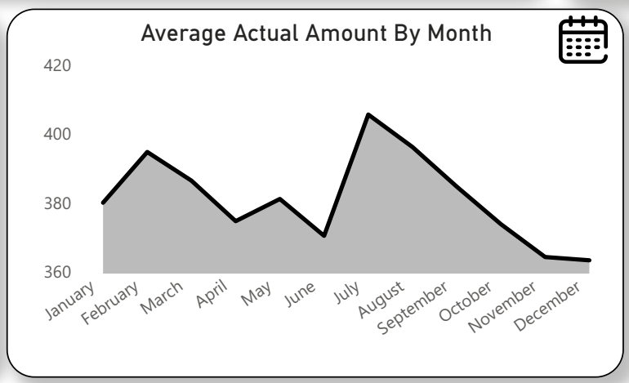
Question 4
Sales Amount Average By month
The Average amount per month are relatively the same and with july being the highest month with 405 average a month followed by february.

Slide 11
RECOMMENDATIONS

Slide 12
AFTER RUNNING MULTIPLE QUERIES ON OUR DATASET, THESE ARE THE FUTURE PRICE I CAN PREDICT DAILY FOR EACH CATEGORIES TO AVOID OVERSTOCKING AND UNDERSTOCKING, KEEP IN MIND THAT THIS IS MAJORLY BASED ON OUR DATASET AND WE ADDED A LITTLE OF OUR HUMAN INTUITION JUST TO INFLUENCE THE RESULT OF THE ANALYSIS.
COFFEE_SALES : we can stick to 500 to the range of 700 PLUS amount, with this we should be able to attend to daily sales amount and also control overstocking and understocking which would help maximize customer satisfaction and also control cost
FOOD_SALES : 500 Amount to the range of 700 PLUS Amount
LABOR : 200 Amount to the range of 400 PLUS amount per day
MARKETING : 200 Amount to the range of 400 PLUS amount per day
INGREDIENT COST: 200 Amount to the range of 400 PLUS amount per day
RENT : 200 Amount to the range of 400 PLUS amount per day
UTILITIES : 200 Amount to the range of 400 PLUS amount per day
NOTE : There are month with higher daily sales average than the other months and months we should pay attention to are : July, February, March, August and September and while implementing the use of this forecast, i took my time to look into overall sales and i noticed that there was a decline in sales, starting from July to November and the months before that also has not seen any improvement in sales but consolidations.

Slide 13
Conclusion
Implementing the current amount range would definitely help reduce the cost and also help reduce overstocking and provide more stocking options

